Slide 1
Version control system

Slide 2
AGENDA
What is Version Control System
How do Version Control System Works
Use of Version Control System
Types of Version Control System
Advantages

Slide 3
Version control system
Version control systems are a category of software tools that helps record changes to files by keeping a track of modifications done to the code.
Version control allows you to manage changes to files over time. You can use version control to version code, binary files, and digital assets.
This includes version control software, version control systems, or version control tools.
Version control is a component of software configuration management.

Slide 4
How do VCS works?
Manages Multiple Versions of the Source Code files
Continuous Integration – Code Review and Testing
Preserving History
Who
When
What
Why
Disaster Recovery
Replica Maintained

Slide 5
Use of VCS
A repository: It can be thought as a database of changes. It contains all the edits and historical versions (snapshots) of the project.
Copy of Work (sometimes called as checkout): It is the personal copy of all the files in a project. You can edit to this copy, without affecting the work of others and you can finally commit your changes to a repository when you are done making your changes.

Slide 6
Types of VCS
Local Version Control Systems
Centralized Version Control Systems
Distributed Version Control Systems

Slide 7
Local Version control system
It is one of the simplest forms and has a database that kept all the changes to files under revision control.
RCS is one of the most common VCS tools. It keeps patch sets (differences between files) in a special format on disk.
By adding up all the patches it can then re-create what any file looked like at any point in time.

Slide 8
Centralized version control system
Centralized version control systems contain just one repository and each user gets their own working copy. You need to commit to reflecting your changes in the repository. It is possible for others to see your changes by updating.
Two things are required to make your changes visible to others which are:
You commit
They update
Example: SVN (Subversion)

Slide 9
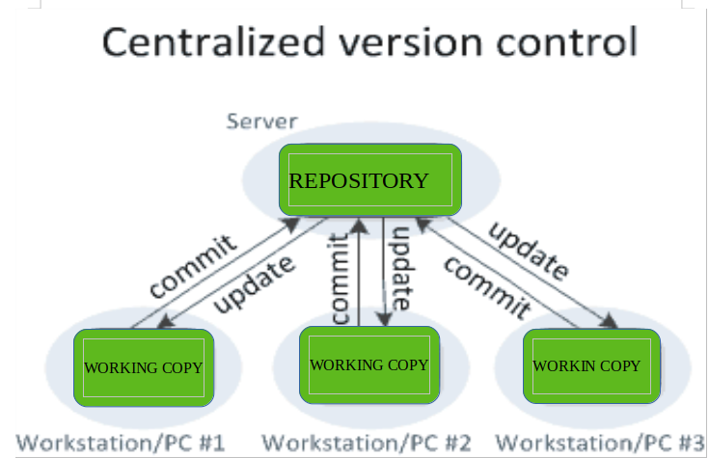
Centralized version control system

Slide 10
Pros and cons of cvcs
Pros:
Makes collaboration amongst Developers along with an insight to a certain extent of what others are doing.
It allows administrators to fine-grained control over who can do what.
Cons:
The most obvious is the single point of failure that the centralized repository represents if it goes down during that period collaboration and saving versioned changes is not possible.

Slide 11
Distributed version control system
Distributed version control systems contain multiple repositories.
Each user has their own repository and working copy.
Just committing your changes will not give others access to your changes.
This is because commit will reflect those changes in your local repository and you need to push them in order to make them visible on the central repository.
Similarly, When you update, you do not get other’s changes unless you have first pulled those changes into your repository.

Slide 12
Distributed version control system
To make your changes visible to others, 4 things are required:
You commit
You push
They pull
They update
Example: GIT

Slide 13
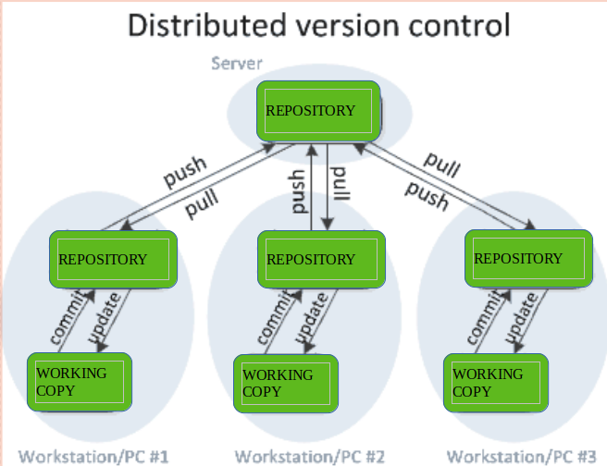
Distributed version control system

Slide 14
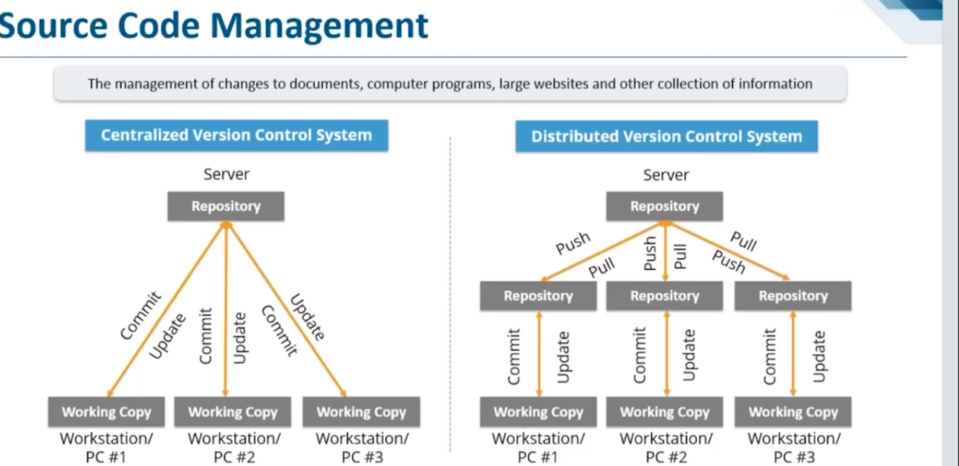
Comparison

Slide 15
advantages
Manage Development
Automate Processes
Enhance Collaboration
Values Assets Protected

Slide 16
Basic concepts
Tracking changes
Committing
Revisions and Changesets
Getting updates
Conflicts
Diffing
Branching
Merging

Slide 17
Concepts
Repository:
The set of files or directories that are under version control are more commonly called a repository.
Tracking Changes:
Whenever a file is modified, the changes are tracked and recorded by the Version Control.

Slide 18
Concepts
Committing:
Whenever a file is modified, the version control system will wait for us to submit our changes as a single collection of actions. This process is known as Commit.
Revisions and Changesets:
When a commit is made, the changes are recorded as a changeset and a unique number is provided as a revision. (Eg: 1,2,3, or 846eee7d92415cfd3f8a936d9ba5c3ad345831e5)
A changset will include a reference to the person who made the commit, when the change was made, the files or directories affected, a comment and even the changes that happened within the files (lines of code).

Slide 19
concepts
Getting updates:
As members of your team commit changes, it is important that you have the latest version. Having the latest version reduces the chance of a conflict.
Getting the latest changes from a repository is as simple as doing a pull or update from another computer (usually a hosted or centralized server).
When an update or pull is requested, only the changes since your last request are downloaded.

Slide 20
concepts
Conflicts:
If two or more members have modified the same code, that results in Conflict.
In that Scenario, the version control system will provide a way to view the difference between the conflicting versions, allowing you to make a choice.
We may either edit the files manually to merge the options, or allow one revision to win over the other.
We may want to collaborate with the person who made the other commit to make sure we are not undoing their important work!

Slide 21
Concepts
Diffing:
By viewing a diff, we can compare two files or even a set of files to see what lines of code changed, when it changed and who changed it.
Most version control tools let us to compare two sequential revisions, but also two revisions from anywhere in the history.

Slide 22
concepts
Branching :
When there is a need to work on a new feature, Instead of committing this code directly to the main set of files (usually referred to as trunk or master), we can create something called a branch.
A branch allows us to create a copy (or snapshot) of the repository that we can modify in parallel without altering the main set.
We can continue to commit new changes to the branch as you work, while others commit to the trunk or master without the changes affecting each other.

Slide 23
concepts
Merging:
By merging the branch with the trunk or master (or even another branch), the version control tool will attempt to seamlessly merge each file and line of code automatically.
Once a branch is merged it then updates the trunk or master with the latest files.

